Slide 1
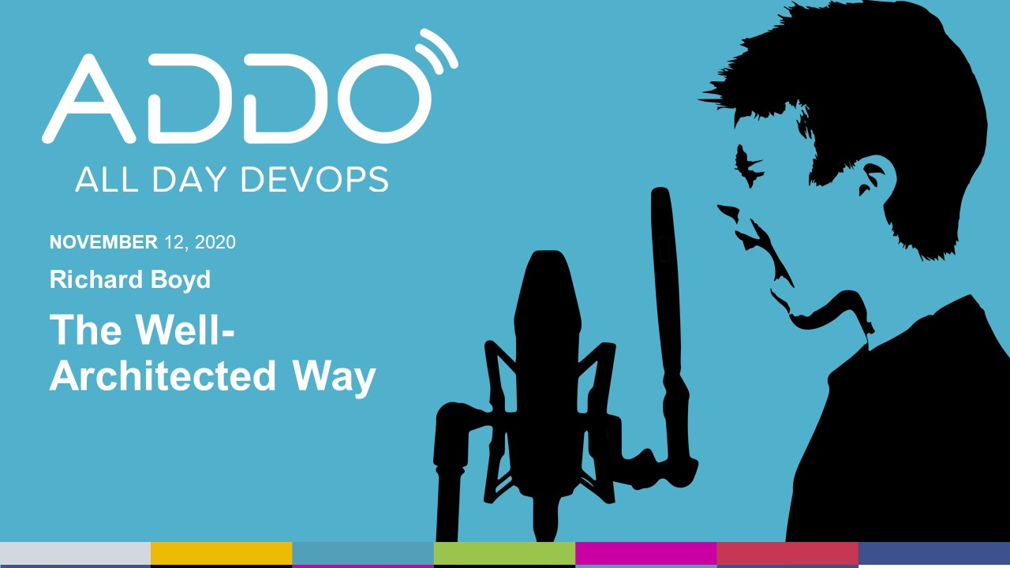
AWS Deck template
Subtitle
Social handles
Team or presenters name
Date

Slide 2

Who am I?
Solutions Architect at Amazon Web Services
Part of the AWS Well-Architected GEO SA Team
6+ years leading Operations teams at Startups
8+ years in systems engineering for the DoD
DevOpsDays and ServerlessDays Organizer in Austin, TX
Iraq War Veteran & Eagle Scout
Part-time IT Support to a 3rd Grader doing distance learning
@richardboydii on Twitter

Slide 3
You’ll Learn About
The Well-Architected Framework
Design Principles, Best Practices, and Tradeoffs
Running a Review with the Well-Architected Tool

Slide 4


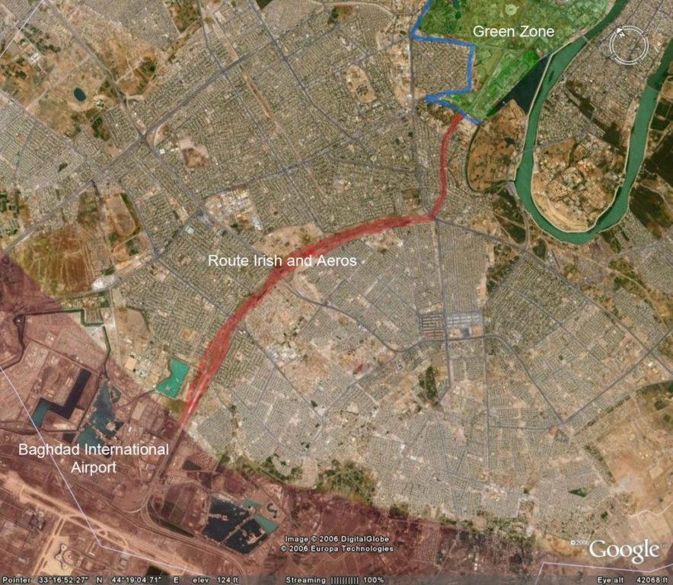
Let’s start with a story about risk …
Notes:
Between 2003 and 2004 I was stationed in Baghdad Iraq with the 1st Armored Division. 5 – 8 times per week we had to drive outside the wire (that means outside the perimeter of our base). One of those main routes I’d drive was Route Irish.
Route Irish was a 7.5 mile highway that linked Baghdad International Airport (BIAP) and the Green Zone, where the US diplomatic mission was based. It was a straight stretch of highway, mostly flat, with a gentle curve from southwest to northeast. It was also one of the deadliest roads in Iraq. Hundreds of troops were injured or killed over the years travelling on it or trying to keep it secure.
Every time we’d set out, we’d conduct a Risk Management exercise. We’d go over who would be in what vehicle, what their roles are, how we would react individually and as a group to events. FM 100-14 (now superseded by ATP 5-19) lays out this Risk Management process and gave us a guide on how to make sure that we had a Plan A, B, C, D, and E.

Slide 5
Q: Why don’t we have a Risk Management process for building things in the cloud?
A: We do …

Slide 6
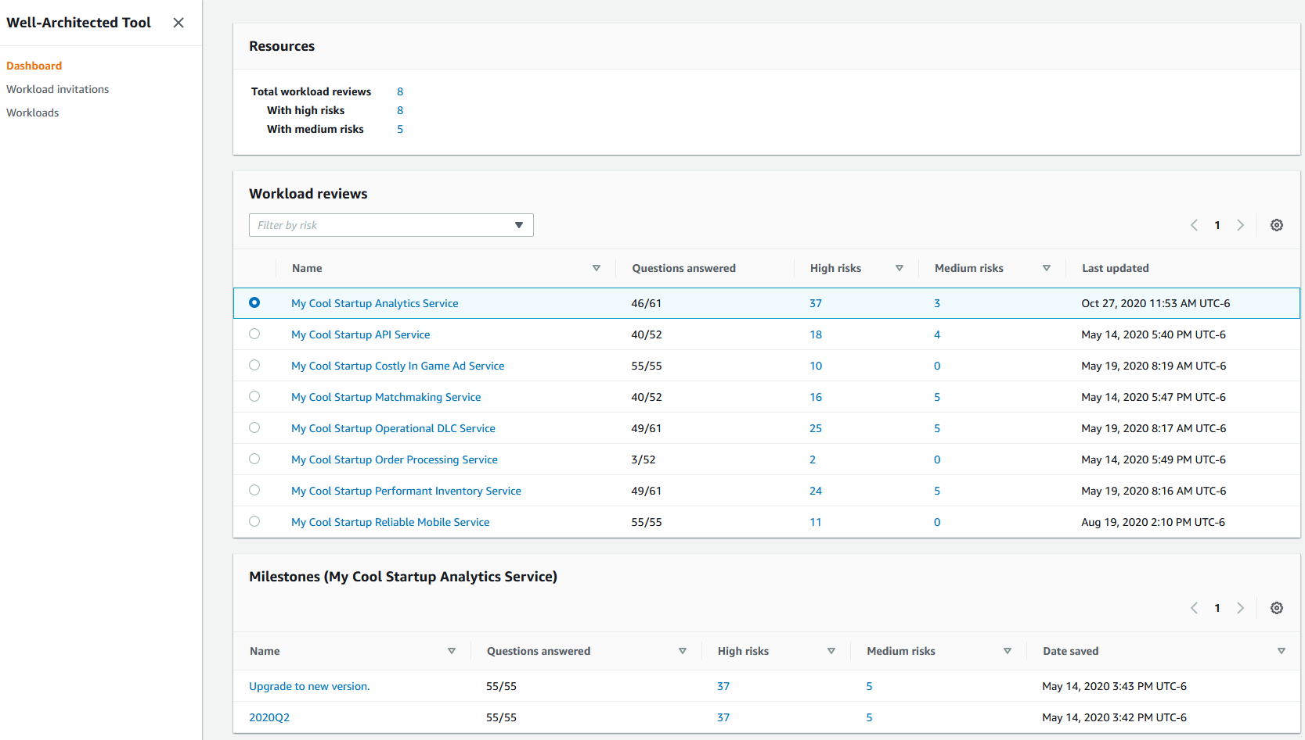
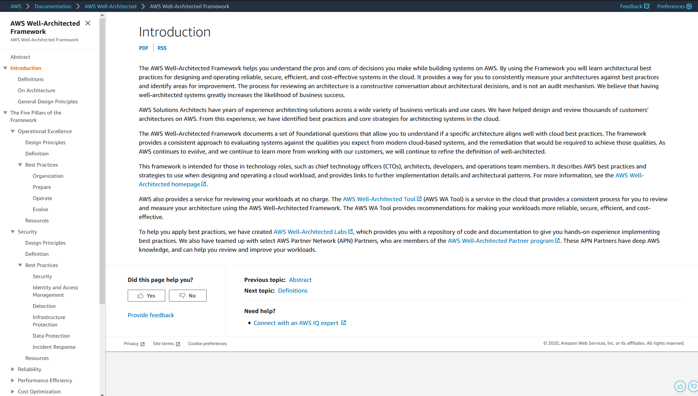


What is Well-Architected?
A Framework
A Toolbox

Slide 7
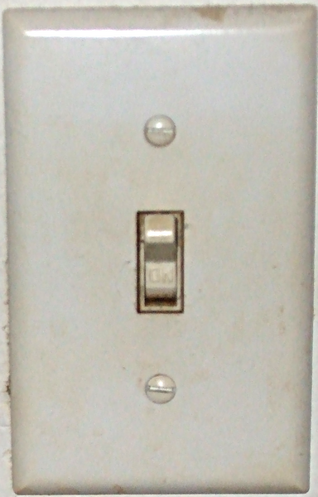
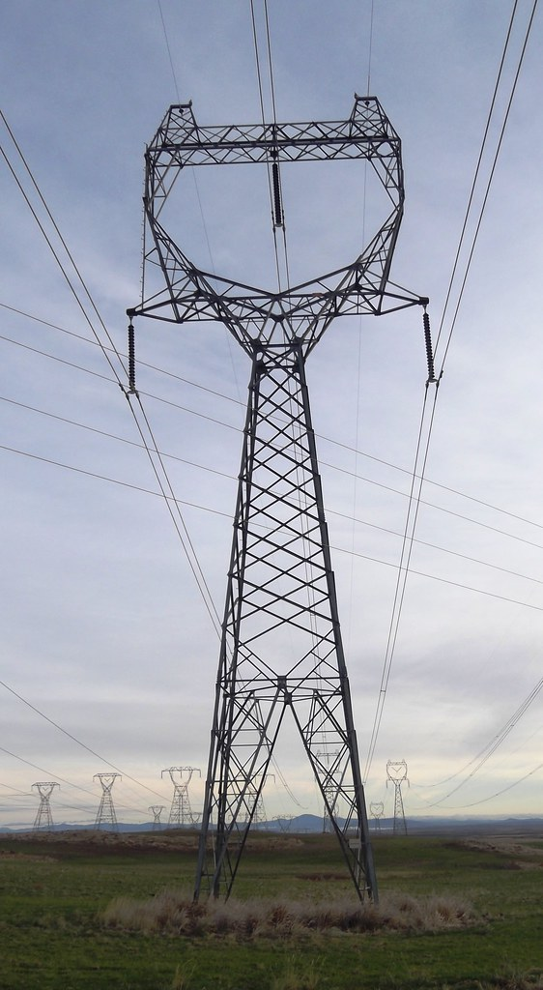
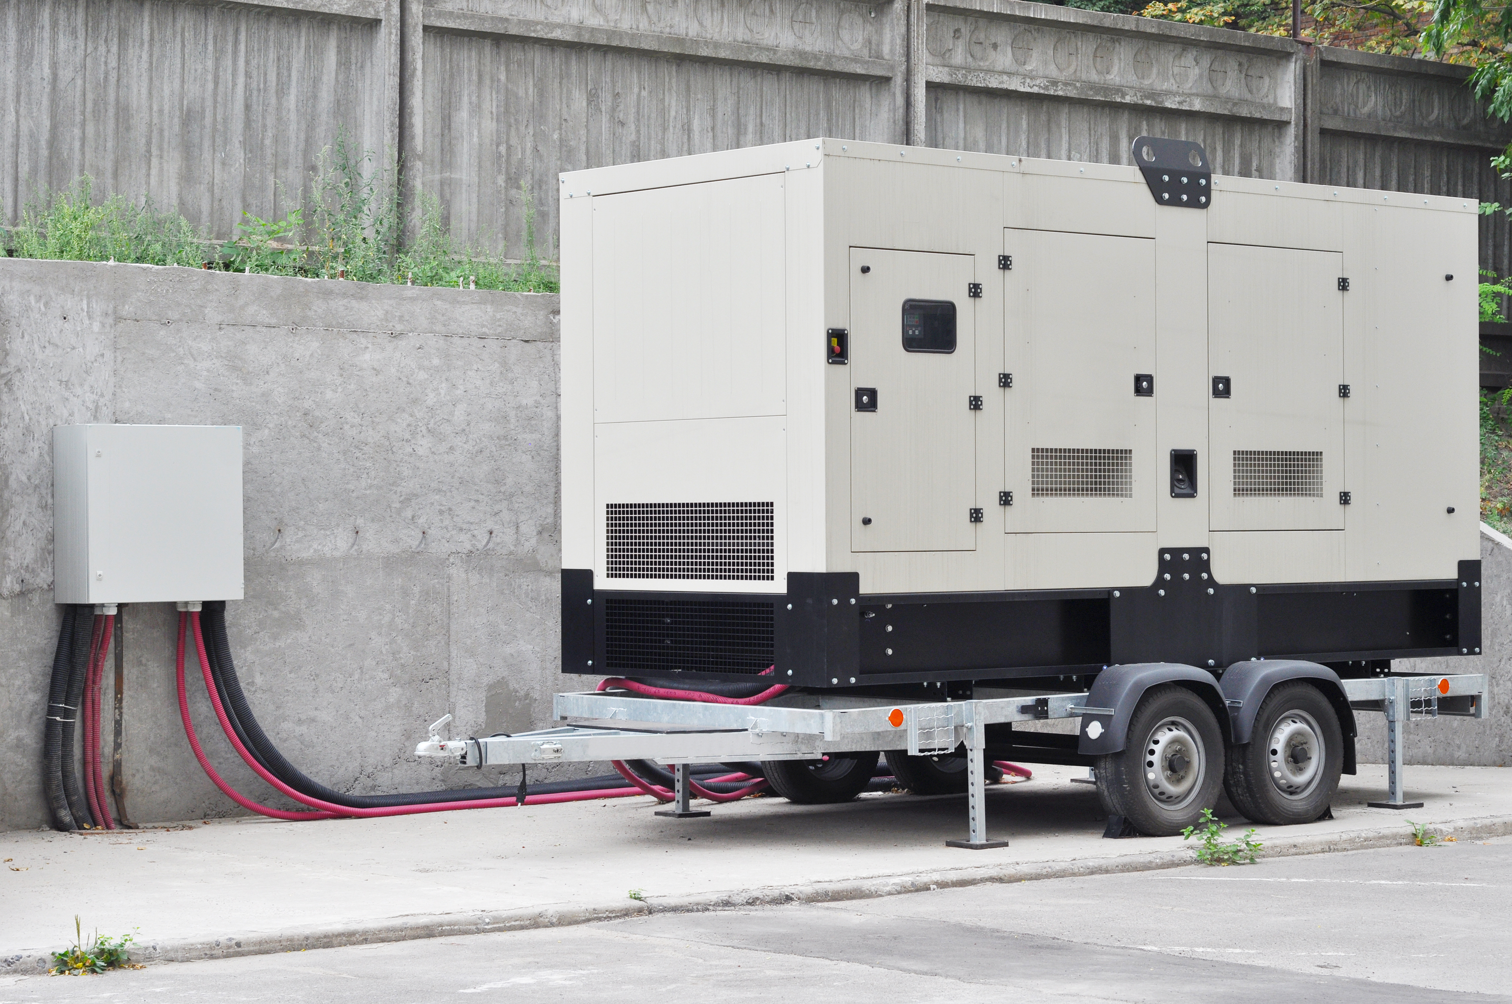
Data Center vs Cloud
Data Center Operations
Cloud Operations
Notes:
Building and operating on premises workloads is like owning a generator to power your house. The cost outlay is up front to purchase and then there’s ongoing fees like fuel and maintenance costs. There’s excess capacity between what you need to power your home and what the generator produces, or you can have a shortfall of power and not be able to keep all the lights on. It also takes a lot of domain knowledge about engines and power generation to operate and keep running.
The cloud is like transitioning to running on the power grid.

Slide 8
Key Terms
Workload: The people, processes, and technologies that together deliver value to the customer.
Best Practice: A recommended thing you should do when you build and operate a Workload in the Cloud.
High Risk Issue: The absence of a Best Practice; these are areas for improving your Workload health.

Slide 9






What is a Workload?
Processes
Business Value
People
Technology

Slide 10
Can you answer the question: “Are you Well-Architected?”

Slide 11
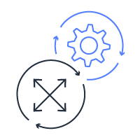




The Pillars of the Framework
Operational Excellence
Security
Reliability
Performance Efficiency
Cost Optimization

Slide 12
Framework Design Principles
Stop guessing your capacity needs
Test systems at production scale
Automate to make architectural experimentation easier
Allow for evolutionary architectures
Drive architectures using data
Improve through game days

Slide 13
Questions in the Framework
REL 3: How do you design your workload service architecture?
COST 4: How do you decommission resources?
OPS 1: How do you determine what your priorities are?
SEC 7: How do you classify your data?
PERF 8: How do you use tradeoffs to improve performance?

Slide 14
A Natural Tension
Latency
Money
Performance Efficiency
Cost Optimization

Slide 15
Understand Your Tradeoffs
Notes:
When a Workload is brand new, your focus may be on getting out of Beta and into a minimum lovable product. At this stage your focus may be on Operations and Performance which is absolutely fine.
But as the workload evolves and you hit that MVP phase, your priorities shift. Now you’re starting to think about Reliability and Cost Optimization more. You need more stability but need to start thinking about costs as you grow.
When you hit the front page of Reddit all of a sudden traffic spikes and everything breaks.

Slide 16
When should I run a Well-Architected Review?

Slide 17
The Well-Architected Tool - Dashboard
Overview of all Workloads and risk profile.
Details about each Workload, including High Risk (HRI) and Medium Risk (MRI) Issues along with last updated date.
Milestones are a point-in-time snapshot of your Workload Health.

Slide 18
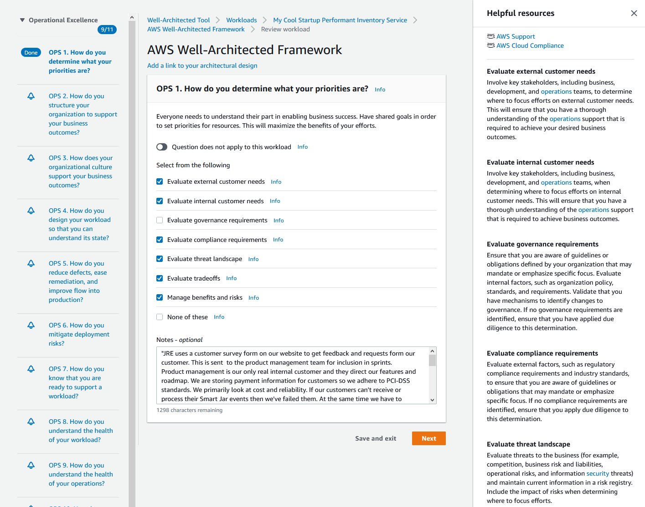
The Well-Architected Tool - Review
Questions grouped by Pillar.
Question and best practices ordered from “should have” to “nice-to-have”.
Educational links and details on each best practice.

Slide 19

Running a Review
Scope the Workload
Identify a Workload Sponsor
Open the Well-Architected Tool

Slide 20
The Well-Architected Cycle
Other Workloads
Improve
Prepare
Review

Slide 21
Recap
What is the Well-Architected Framework
Design Principles Best Practices, and Tradeoffs
Running a Review with the Well-Architected Tool

Slide 22
Thank you! Join me on Slack in #2020-modern-infrastructure for a Q&A!
@richardboydii

